Slide 1




NEXT GEN EMPLOYABILITY PROGRAM
Creating a future-ready workforce
Team Members
College Name
Student Name :Nandhakumar S
Student ID : 311121205039
Loyola-Icam College Technology of Engineering and Technology

Slide 2

CAPSTONE PROJECT SHOWCASE
Project Title
Music app using Django-Nandhakumar(5039)_LICET
Abstract | Problem Statement | Project Overview | Proposed Solution | Technology Used | Modelling & Results | Conclusion

Slide 3
Abstract
In today's digital age, music consumption has largely shifted towards online platforms, making the development of efficient music applications crucial. This project focuses on creating a music app using Django, a high-level Python web framework. The application aims to provide users with a seamless music listening experience, allowing them to discover, stream, and organize their favorite tracks.
Source :

Slide 4
Problem Statement
Existing music applications often lack customization options and struggle with performance issues. Moreover, some users may face difficulties in discovering new music tailored to their preferences. This project addresses these issues by developing a music app that prioritizes user experience, performance, and personalized recommendations.
Source :

Slide 5
Project Overview
The project entails the development of a music application using Django, which will include features such as user authentication, playlist creation, song recommendation algorithms, and a user-friendly interface for seamless navigation. The app will leverage Django's robust capabilities to ensure scalability, security, and efficient data management.
Source :

Slide 6
Proposed Solution
.
The proposed solution involves implementing various modules within the Django framework to handle different aspects of the music application. This includes user authentication using Django's built-in authentication system, integrating third-party APIs for music recommendations, and designing intuitive user interfaces for enhanced user experience.
Source :

Slide 7

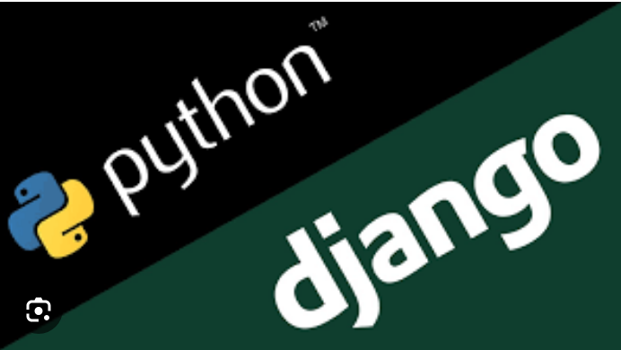
Technology Used
Front-end
Back-end
Source :

Slide 8
Modelling & Results
The development process involves creating data models to represent users, songs, playlists, and other entities within the application. Additionally, algorithms for personalized music recommendations will be implemented and tested for accuracy and effectiveness. The results will be evaluated based on performance metrics, user feedback, and overall satisfaction.
Source :

Slide 9
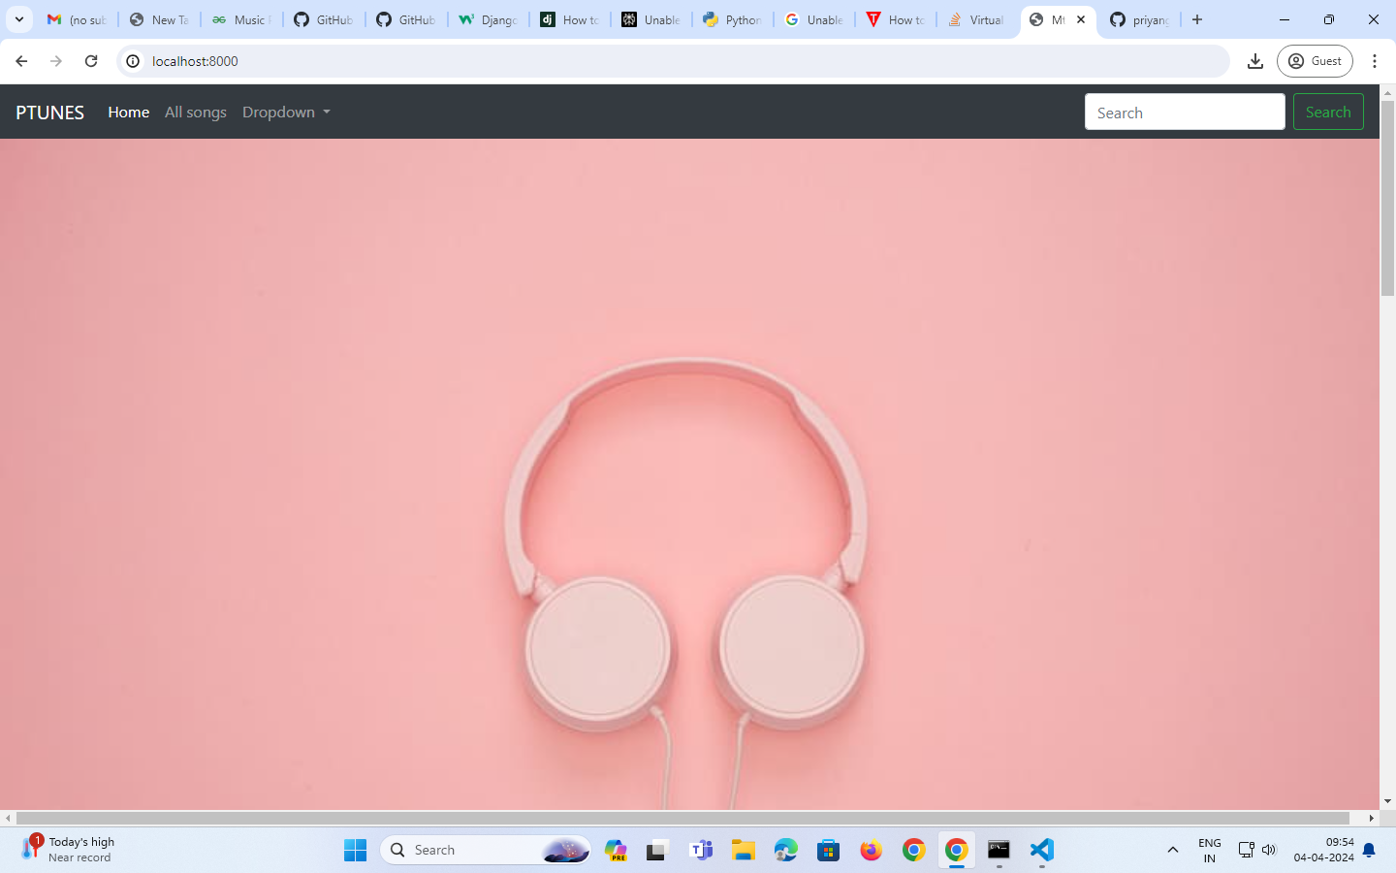
Homepage

Slide 10
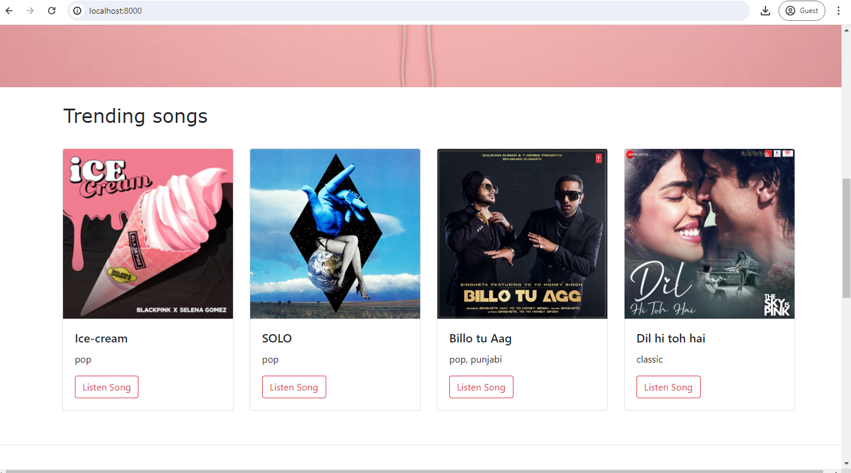
About-Us-Page(Trending Page)

Slide 11
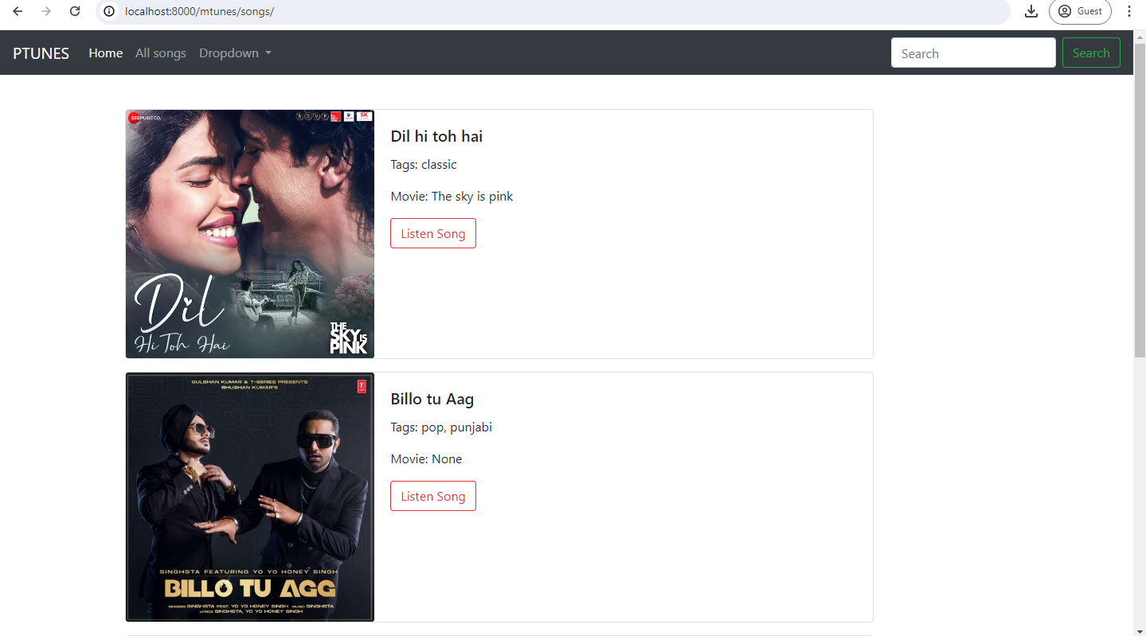
Service-Page

Slide 12
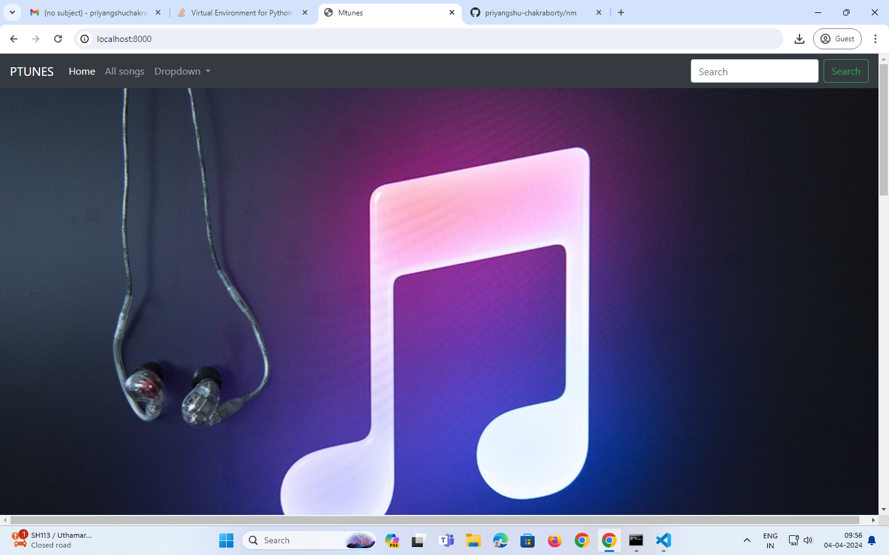
Departments-Page

Slide 13
Future Enhancements:
Future enhancements for the music app built with Django could include integrating advanced machine learning algorithms for more accurate and personalized music recommendations. These algorithms could analyze users' listening habits, preferences, and social interactions to suggest relevant tracks, artists, and playlists. Additionally, enhancing the app's social features by allowing users to connect with friends, share playlists, and collaborate on curated collections could foster a sense of community within the platform. Furthermore, incorporating support for offline playback and synchronization across multiple devices would enhance the app's accessibility and convenience for users on the go. Continuous updates to the app's interface and functionality based on user feedback and emerging technologies would ensure that it remains competitive and aligned with evolving trends in the music streaming industry.

Slide 14
Conclusion
In conclusion, the development of a music app using Django offers an opportunity to address the shortcomings of existing platforms and provide users with a superior music listening experience. By leveraging Django's powerful features and integrating personalized recommendation algorithms, the application aims to cater to the diverse preferences of music enthusiasts while ensuring efficiency, security, and scalability.
Source :

Slide 15
Thank You!
Notes:
Thank You !!

